Slide 1
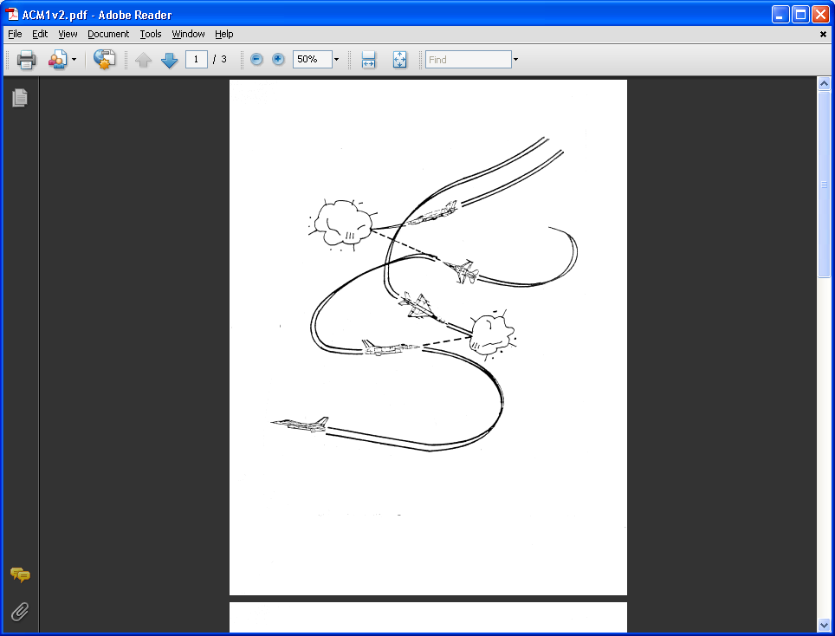
AE 317 Flight Mechanics and Performance
Airfoils and Coefficients
LECTURE 05
Dr. Jeff Ashworth
Aerospace Engineering Department

Slide 2
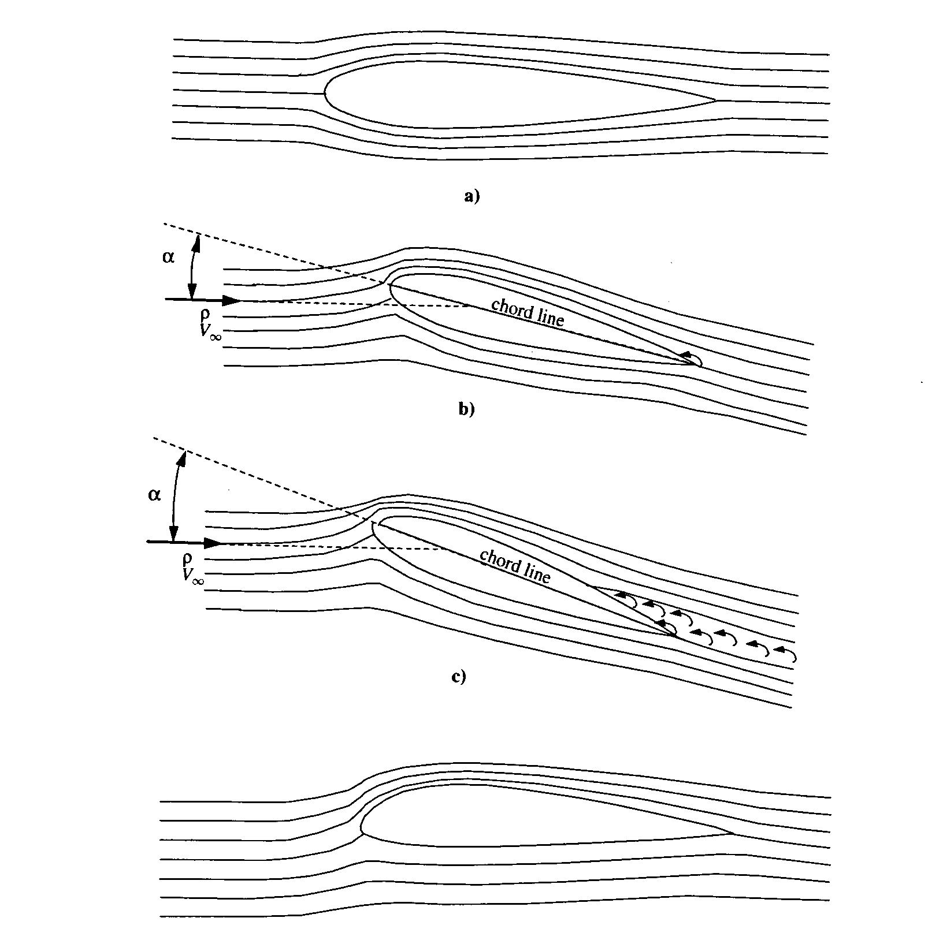
(Brandt)
Notes:
(Brandt)

Slide 3
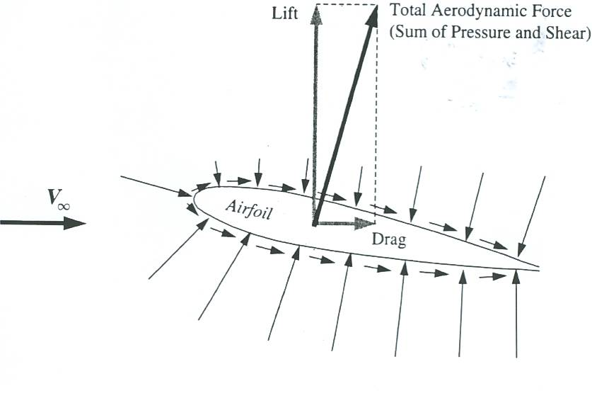
(Brandt)

Slide 4
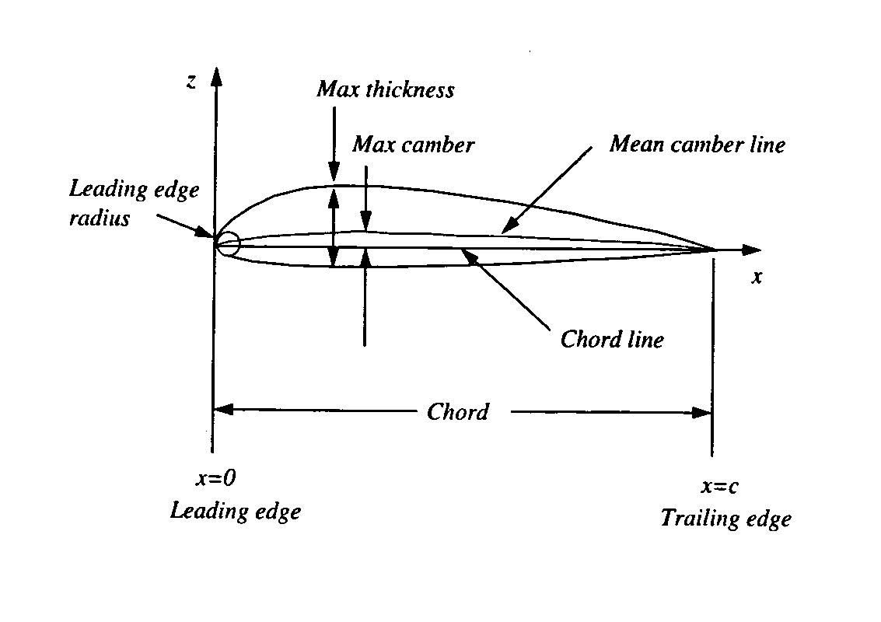
(Brandt)

Slide 5
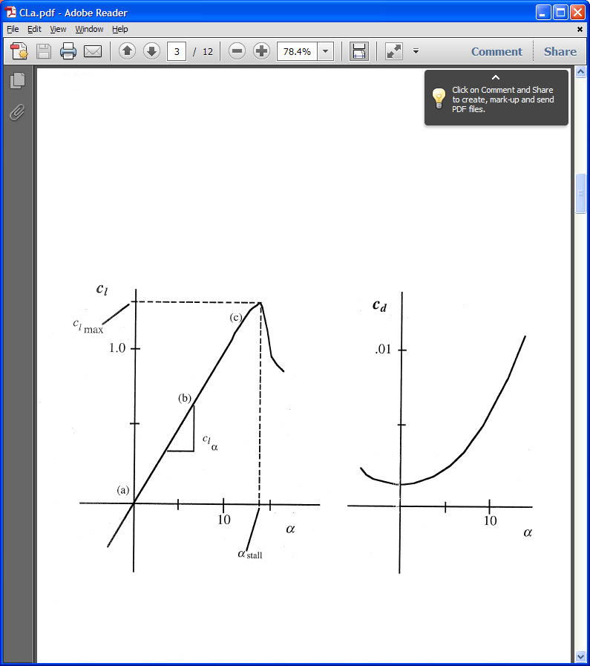
(Brandt)

Slide 6
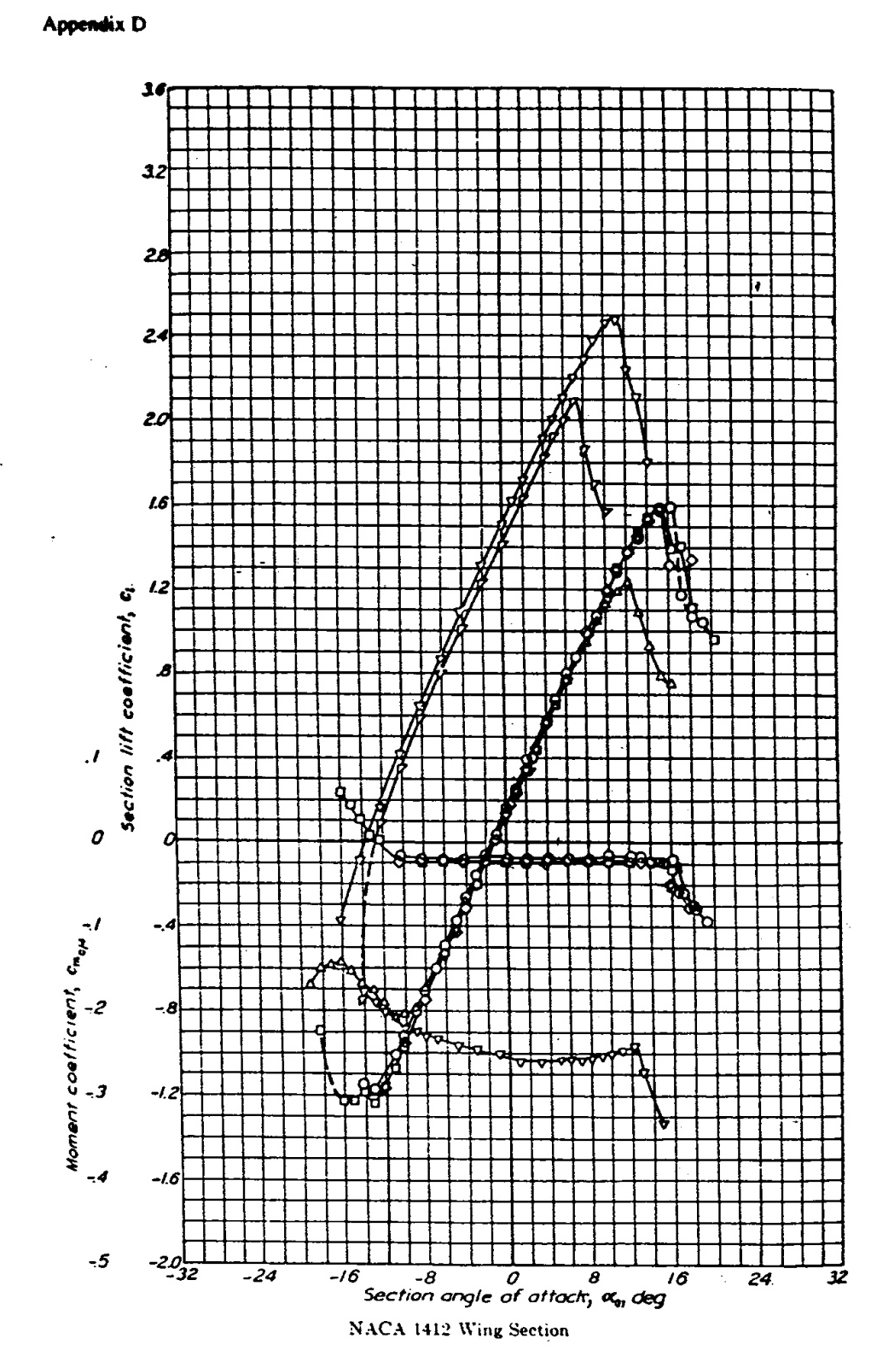

Slide 7
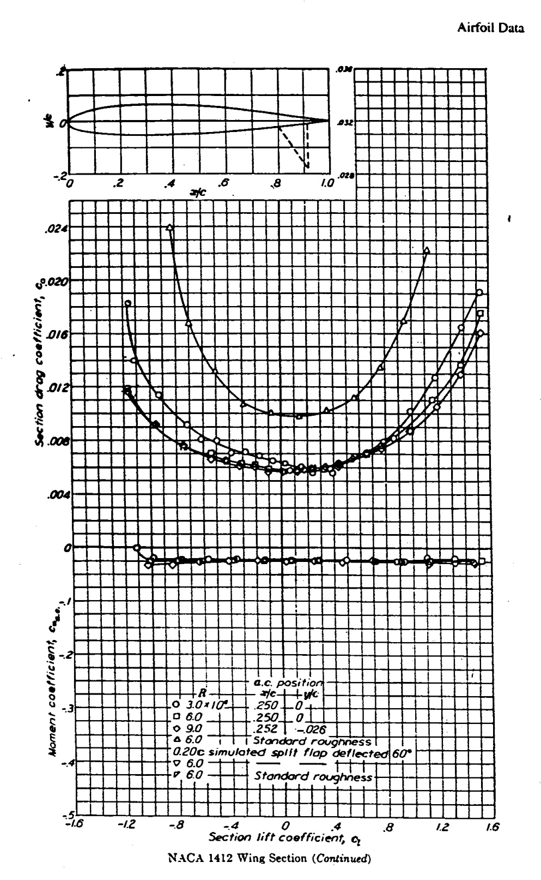

Slide 8
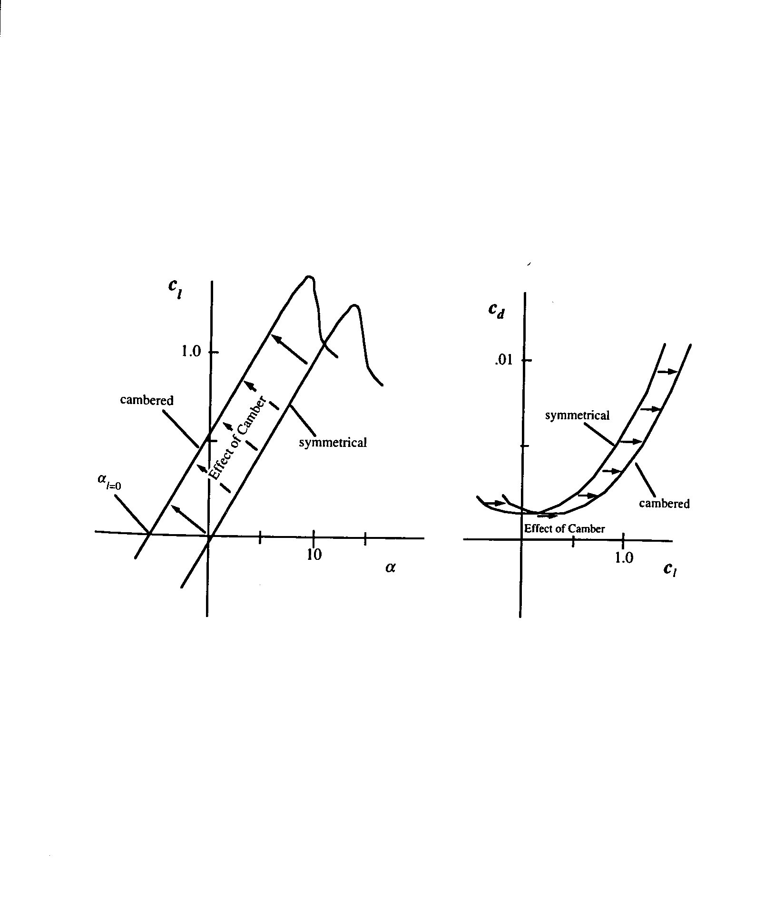
(Brandt)

Slide 9
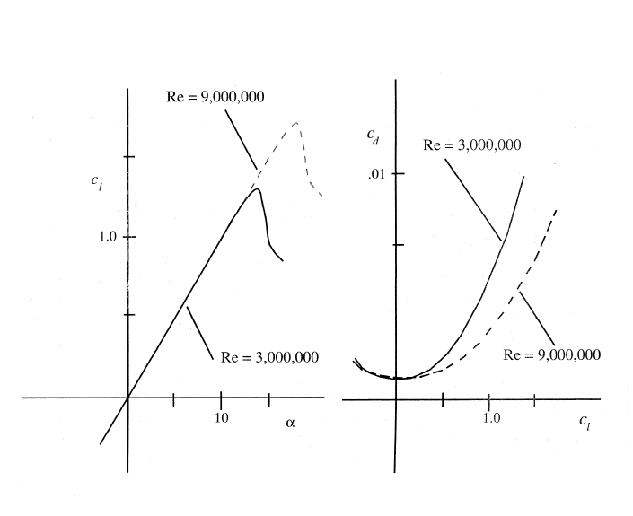
(Brandt)

Slide 10
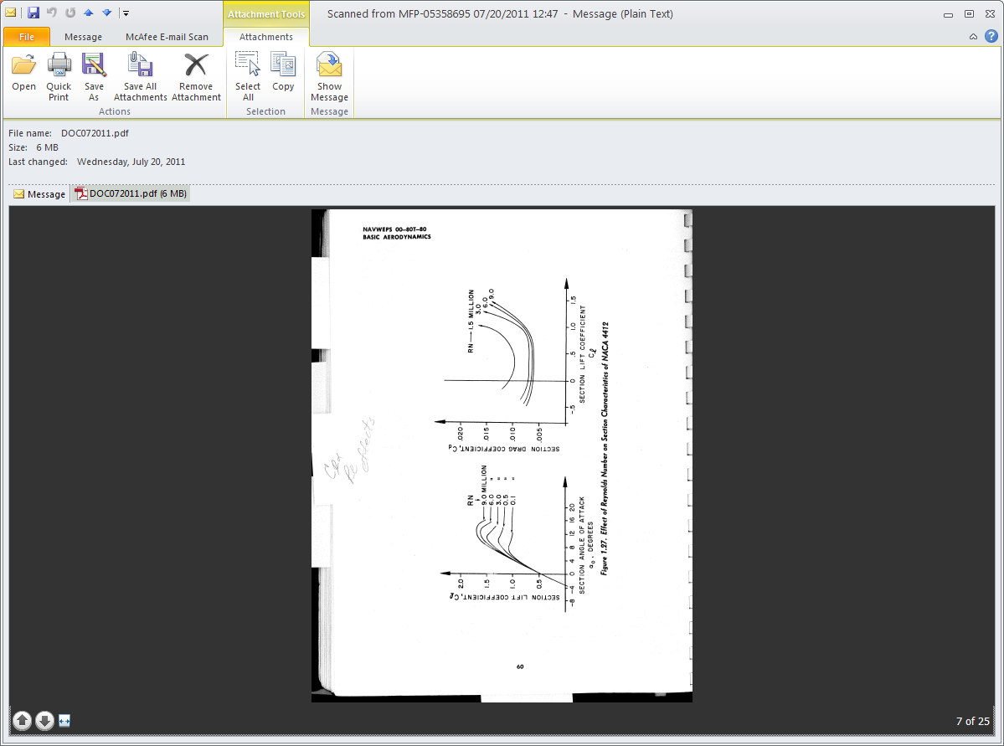
NACA 4412
(ANA)

Slide 11
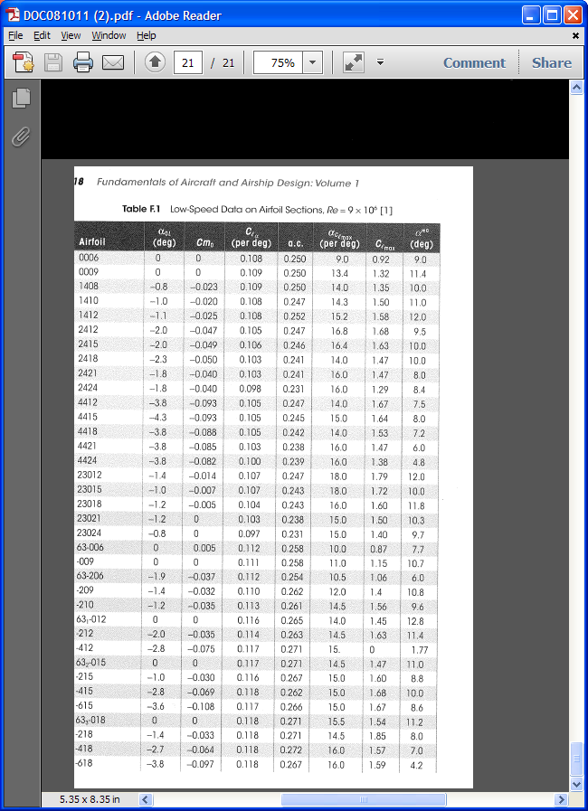
(Nicolai/Carichner)

Slide 12
GOOGLE:
→NACA Airfoils
→Summary of Airfoil Data
NOT: NACA Airfoil Series
(Computer Generated)
→Report #824 dated 1945
Index on Pages 129 & 130

